Slide 1
Solar mobile Power Station, 3/1/2012 “Solar Tech: Kelvin Simonson, Corey Robbins, Stan Kisilitsa, Timmy Maw, Hongsheng Li”
Problem Definition
Competitive Analysis
Create a solar energy back-up system that can store energy to a battery back up and then provide energy during times of power outages
Schedule:
Proposal – 7/1/2011
Data information on solar cells and battery back-ups – 8/1/2011
Working 12V solar charger– 3/1/2012
Resources:
ENGR/CS program at Clark college
PGE
Clark Public Utilities
Pacific Power
PGE, Pacific Power, Clark Public Utilities, and many other small businesses
Cons: These companies are all big name companies and have reliable resources. They also already have the consumer market
Pros: It can be marketed to the above companies and consumers as a potential for a green reusable energy source
Potential Applications
Solution Specifications
Home owners
Small businesses
Large businesses
Government/military buildings
Educational buildings
Operation Description: A bank of solar cells will harness solar energy and store the energy. During time of brief power outages (12-24 hours). The stored energy will then be used to restore basic energy needs during the brief interrupt of power
Component Specifications:
5-watt, 12V solar panel
12V rechargeable deep cycle battery
Housing for battery/Solar panel
Future Improvement Ideas
Calculate data to get a full scale scope of the square footage of solar panels need to keep an average home/buisness supplied with basic energy needs during times of short power outages and be able to switch between solar and battery power.
Engineering & Computer Science Departments

Slide 2
Main Components
8-Watt, 21V solar Panel
$100-$200
12V Deep Cycle Battery
$120
Wire/Wire Terminal
$10
Voltmeter
$5
Switch
$1
Housing
$30
Total = $250-$350

Slide 3
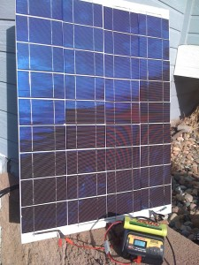
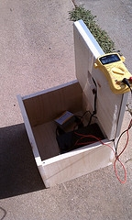
Examples of 12V Solar Chargers

Slide 4
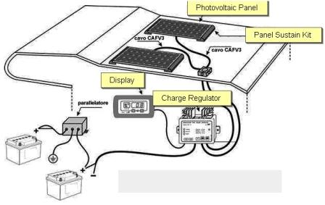
System Layout

Slide 5
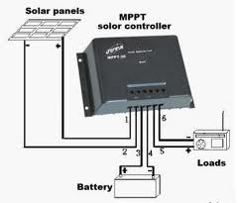
Charger Controller

Slide 6
Schedule
Current: Moving from research to the development stage
Phase 1: 8/30/2011 – 1/1/2012
Construction of 12V solar charging system
Prep for working demo
Possible funding options?
Phase 2: 1/1/2012 – 3/1/2012
Implement charger into working system
Develop Future Ideas for improvement to system

